Slide 1
ARM

Slide 2
RISC DESIGN PHILOSOPHY
Instructions :
Reduced number of instruction classes
Fixed length instruction
Execute in single cycle

Slide 3
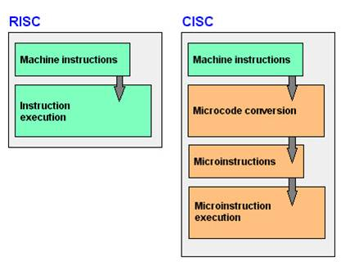
RISC DESIGN PHILOSOPHY
PIPELINE :
processing of instructions is broken down into
smaller units, which can be executed in parallel
more throughput (in comparison with sequential execution )
No need of microcode

Slide 4
RISC DESIGN PHILOSOPHY
PIPELINE (examples) :
Fetch
Decode
Execute
ARM7 (THREE STAGE PIPELINE)
Fetch
Decode
Execute
Memory
Write
ARM9 (FIVE STAGE PIPELINE)
Fetch
Decode
Execute
Memory
Write
Issue
ARM10 (SIX STAGE PIPELINE)

Slide 5
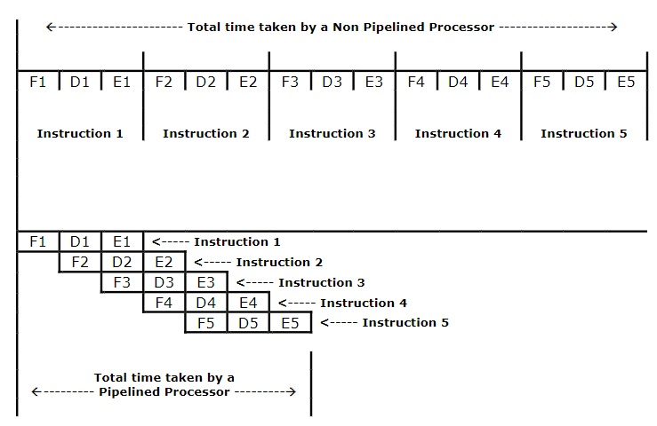
PIPELINED VS NON- PIPELINED µP

Slide 6
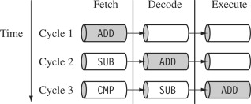
PIPELINE EXAMPLE

Slide 7
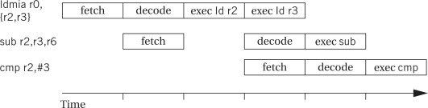
PIPELINE BUBBLE(STALL)

Slide 8
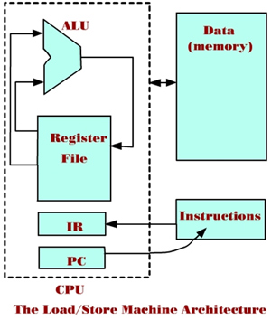
RISC DESIGN PHILOSOPHY
Registers : Large general purpose registers
Load-Store Architecture
Processor Operates only on data held
in registers
Separate load & store instructions transfer
data between the register bank & memory

Slide 9
ARM DESIGN PHILOSOPHY
(RISC ?)
Variable cycle execution for certain instructions
Inline barrel shifter (more complex instruction)
Example : all load -store-multiple instructions
Example : LDMIA R0, {R2,R3} (F-D-E-E)
Example : MOV R7,R5,LSL #2 ; R7 = R5 << 2

Slide 10
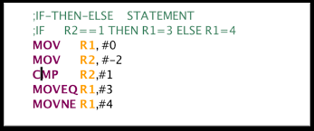
ARM DESIGN PHILOSOPHY
(RISC ?)
Thumb (16-bit) Instruction set
Supports Conditional Execution
Enhanced Instructions
ARM core can execute either THUMB(16-bit) or ARM(32-bit) instruction set
Enhanced DSP instructions to support fast 16 × 16 bit multiplication

Slide 11
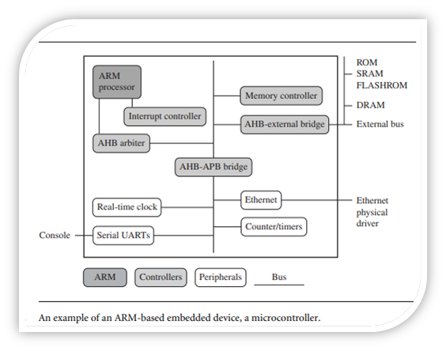
Example of ARM based embedded device
The Advanced microcontroller Bus Architecture(AMBA) introduced in 1996
AHB : ARM HIGH PERFORMANCE BUS
APB : ARM PERIPHERAL BUS

